Slide 1
Custom Tags

Slide 2
Objectives
Tag Libraries
The Custom Tag Development Process
Hunting the Tag
Custom Tag Example
Tag Interfaces and Classes in javax.servlet.jsp.tagext
The “Classic” Custom Tag Event Model
Tags and Implicit Variables
<number>/14

Slide 3
Custom tags
Custom tags are user-defined tags to encapsulation dynamic functionality; an extension of JSP language
  eliminates the possibility of scriptlet tag
  separates the business logic from the JSP page.
  possibility to reuse the same business logic
The javax.servlet.jsp.tagext package contains classes and interfaces for JSP custom tag API.
Custom tag is implemented by writing a Java class called a tag handler.
When a JSP page is translated into a servlet, the custom tag is converted to a called on tag handler
<number>/14

Slide 4
Custom tags development process
Steps to define and use custom tag
  Create the Tag Library Descriptor - .TLD file
    Custom tags will be listed in TLD file
    WEB-INF/tlds/mytag_library.tld
  Write Tag Handler class for custom tag
    SearchTagHandler extends SimpleTagSupport
  Reference the tag library in JSP page using the <taglib> directive
  <%@taglib uri="WEB-INF/tlds/mytag_library.tld" prefix="m" %>
  Use custom tag in JSP page
  <m:search value="${sValue}" criteria="${sCriteria}"/>
<number>/14

Slide 5
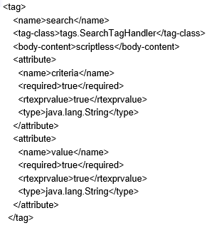
Tag description in TLD file
<number>/14

Slide 6
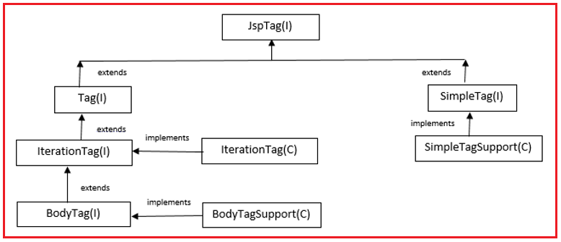
Tag handler class
Two types of tag handlers: simple and classic.
  SimpleTagSupport (JSP 2.0)
  BodyTagSupport (classic JSP 1.1)
<number>/14

Slide 7
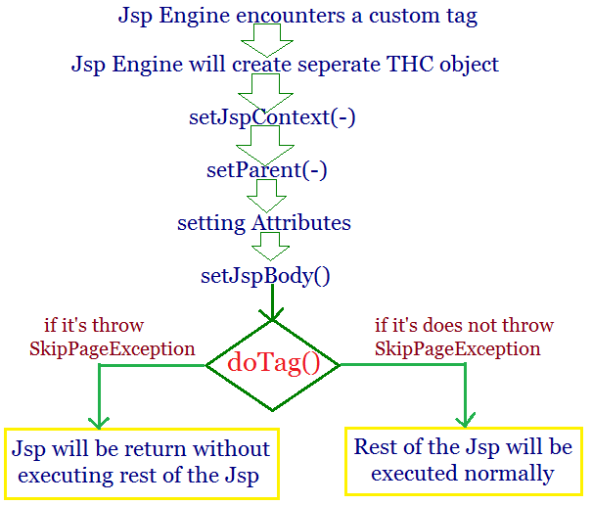
SimpleTagSupport life cycle
<number>/14

Slide 8
Simple Tag handler class
Custom tags may have:
  Empty body
  Tag with attributes
  Body tags
In NetBean
  create Tag handler with SimpleTagSupport
  declare tag body: empty, scriptless, tagdependent
  Tag attribute: attribute name and data type
  writing code for doTag() method
  IDE automatically generates code in TLD file
<number>/14

Slide 9
Simple Tag handler class
For tag with attribute, Tag handler must have variable member with getter/setter method
Simple tag body can include static text, HTML, EL between the start and the end tag, should not contains scripting elements
  Access tag body by invoke getJspBody()
  JspFragment body=getJspBody();
  body.invoke(Writer ); // null: write directly to the jsp page
throw SkipPageException will return without executing the rest of page
<number>/14

Slide 10
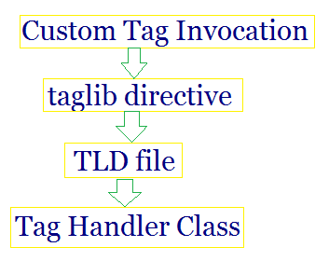
Hunting the Tag
JSP Document
<html>
<body>
<%@taglib uri="test_taglib" prefix="myTag"%>
<myTag:showDate/>
</body>
</html>
START HERE: tag used in JSP page.
Tag Library Descriptor
<taglib>
<tag>
<name>showDate</name>
<tagclass>examples.ShowDateTag</tagclass>
<bodycontent>EMPTY</bodycontent>
</tag>
</taglib>
Tag Handler Class
1000001000000010101010
0000101010100000010010
1000011111111000000000
1000001000000010101010
0000101010100000010010
1000011111111000000000
Finally:
<tag-class> in the TLD maps to a tag handler class.
<number>/14

Slide 11
Tags and Implicit Variables
JspContext class contains getOut() but not remaining jsp implicit object methods
Using the PageContext we can access the JSP implicit variables and access web application attributes.
PageContext pageContext=(PageContext)getJspContext();
HttpSession sess = pageContext.getSession();
… the same for other implicit objects on JSP page
<number>/14

Slide 12
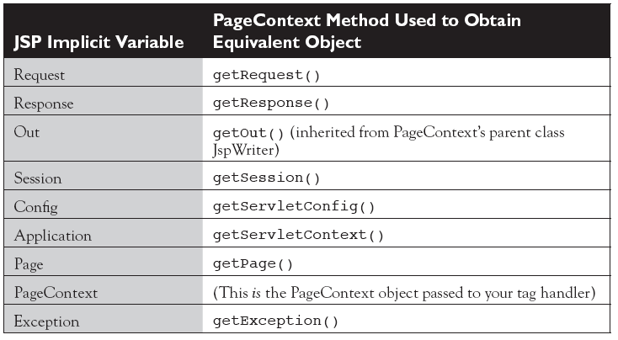
Tags and Implicit Variables…
<number>/14

Slide 13
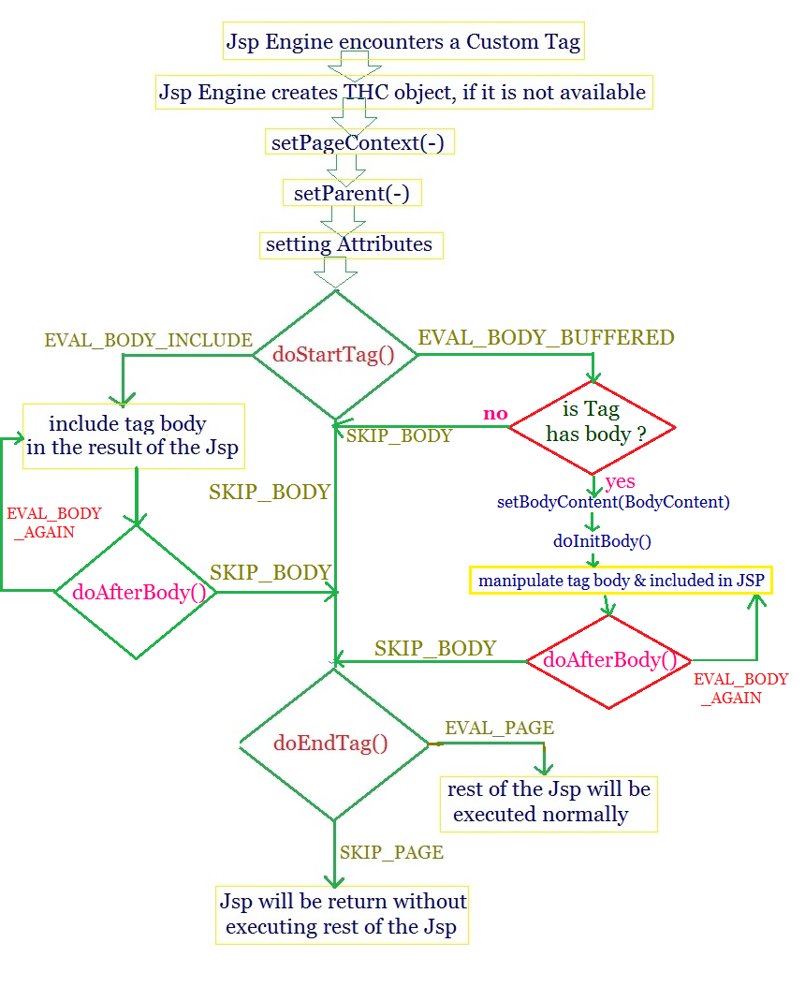
BodyTagSupport life cycle
<number>/14

Slide 14
Writing BodyTagSupport handler
Define class extends BodyTagSupport
In NetBean
  Create Tag handler choosing BodyTagSupport
  Setup tag body: empty, JSP, tagdependent
  Add tag attribute: attribute name and data type
  writing code for doStartTag(), doAfterBody() and doEndTag() method, or writing:
    private void otherDoStartTagOperations()
    private void otherDoEndTagOperations()
    private void writeTagBodyContent(out, bodyContent)
<number>/14

Slide 15
BodyTagSupport handler
For tag with attribute, Tag handler must have variable member with getter/setter method
Body Tag can include static text, HTML, JSP between the start and the end tag;
  Access body by invoke bodyContent
  String data=bodyContent.getString();
  JspWriter out=bodyContent.getEnclosingWriter();
  out.println(data); //output processed body to page
Look at BodyTagSupport life cycle for writing code to handle any part of tag body.
<number>/14

Slide 16
Summary
Custom Tags introduction
The Custom Tag Development Process
  Tag Libraries Descriptor
  Tag Handler class
  Taglib directive
  Using custom tags
Hunting the Tag
Custom Tag extends SimpleTagSupport
Custom Tag extends BodyTagSupport
Custom Tags and Implicit Variables
<number>/14

Slide 17
Constructivity questions
How to handle custom tag body content when using SimpleTagSupport?
Design and implement a simple tag handler that allows printing n times the content of the body tag, if n is not specified, then print it once.
Compare the pros and cons of checking login with Filter settings and with custom tags.
How does the JSP handler distinguish a custom tag from a standard tag?
<number>/14

